Slide 1
The world is your oyster
Презентация к уроку по учебному предмету «Английский язык»
в 8 классе
Учителя английского языка
ГБОУ лицея 144
г. Санкт-Петербурга
Дерендяевой Светланы Васильевны

Slide 2

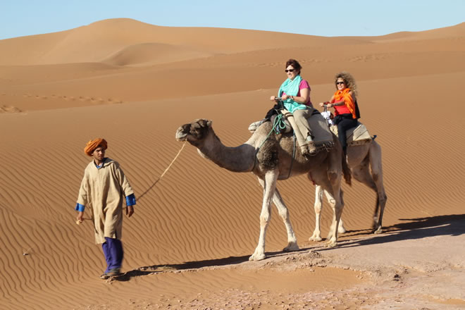
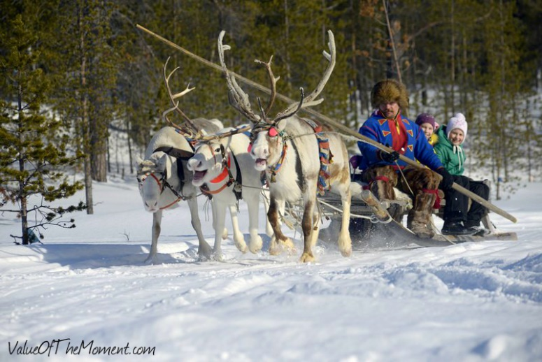
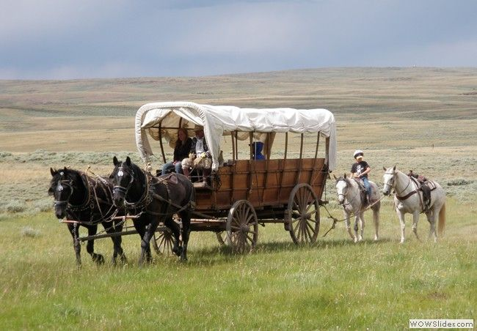
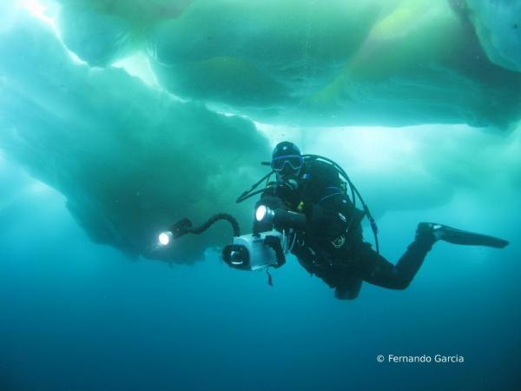
Look at the pictures, listen to the music and answer the questions:
Which of the four places are you at?
What are you doing?
What is the weather like today?
How do you feel?

Slide 3
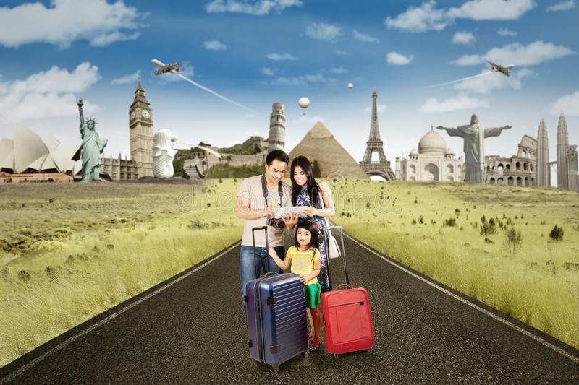
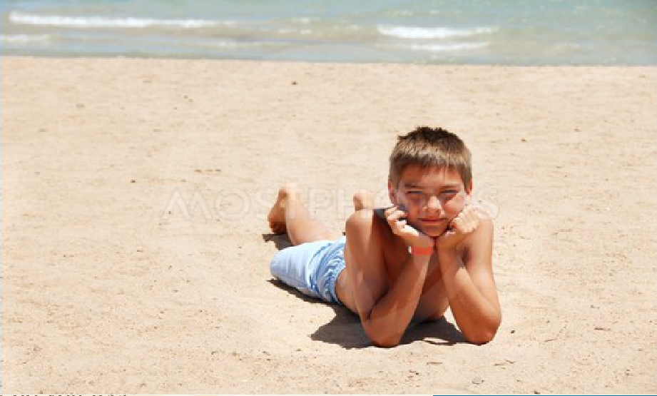
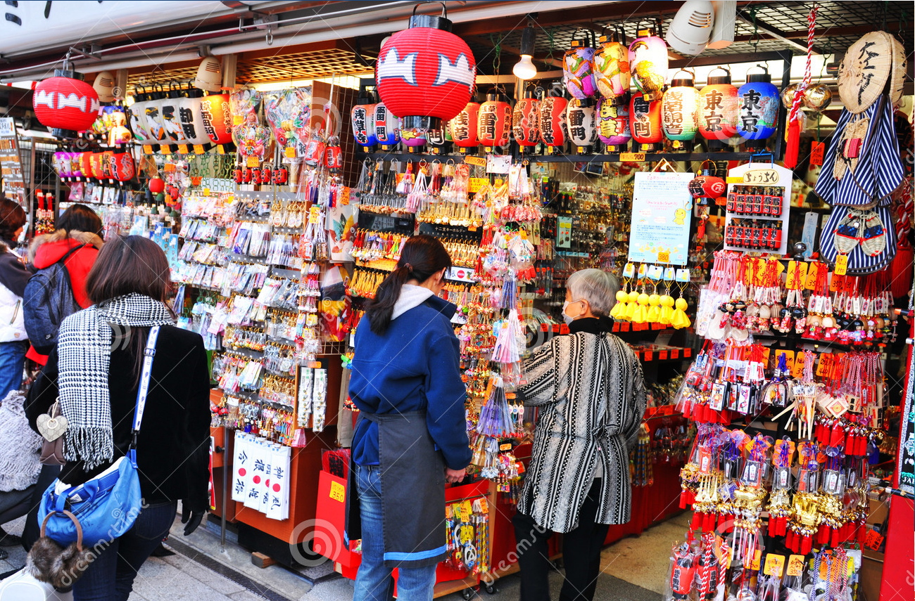
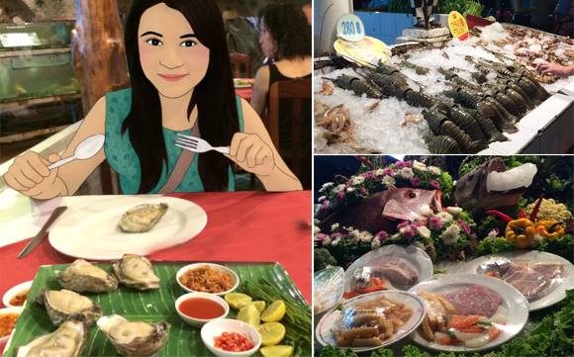
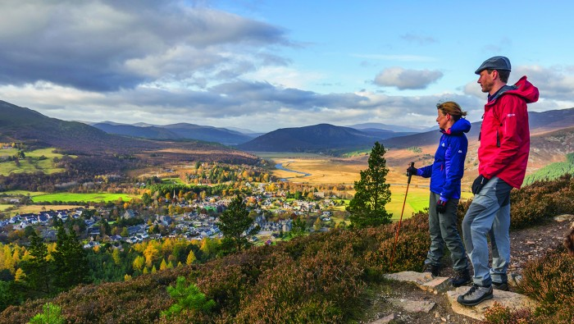
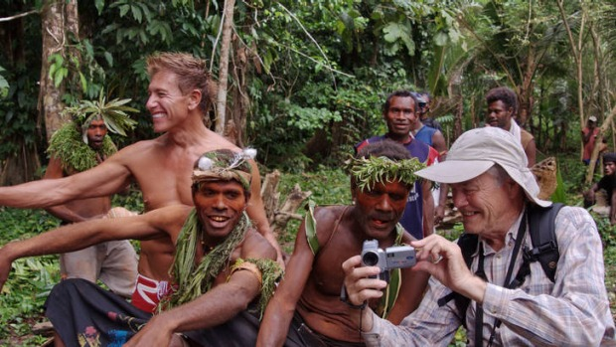
meet the locals
have time to yourself
buy souvenirs /ˌsuːvəˈnɪə(r)
try the local cuisine /kwɪˈziːn/
practise the language
visit museums
visit local markets
lie on the beach all day
see famous landmarks
explore nature
go on guided tours

Slide 4
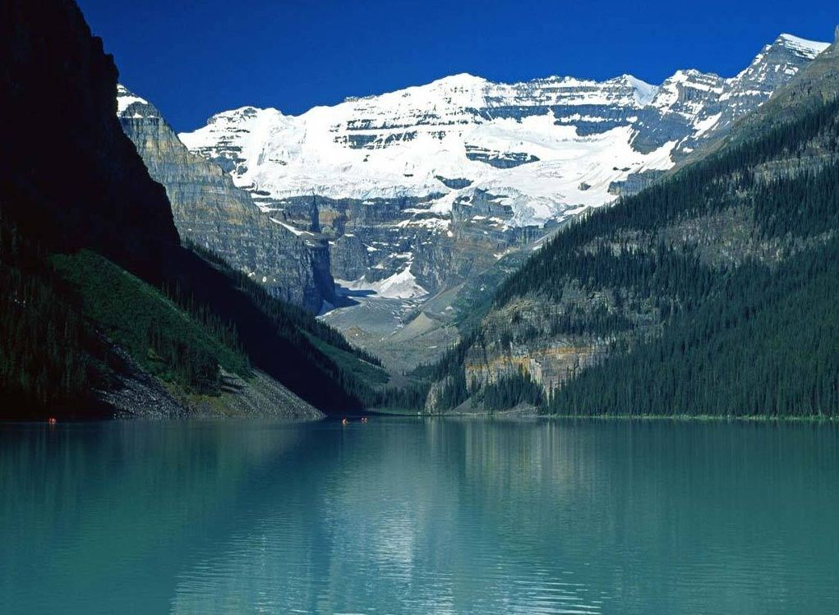
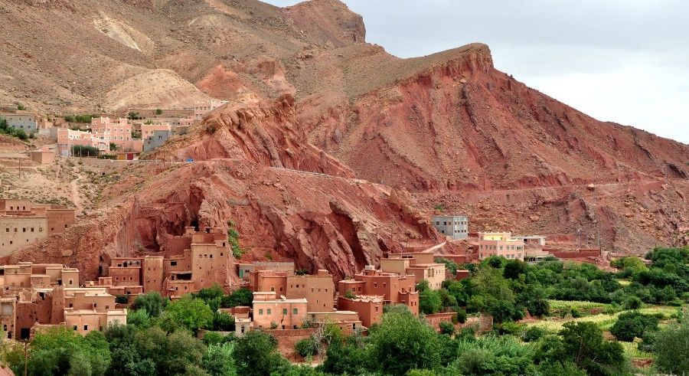
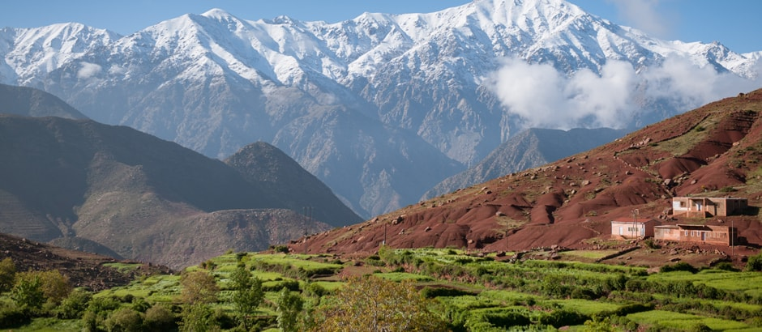
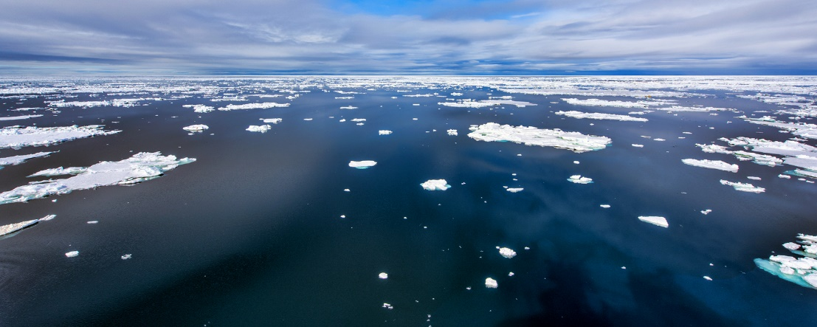
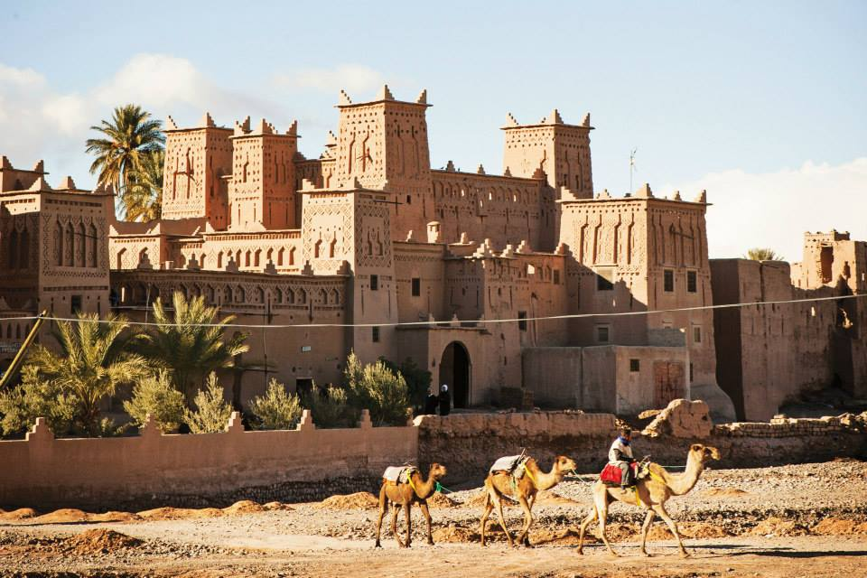
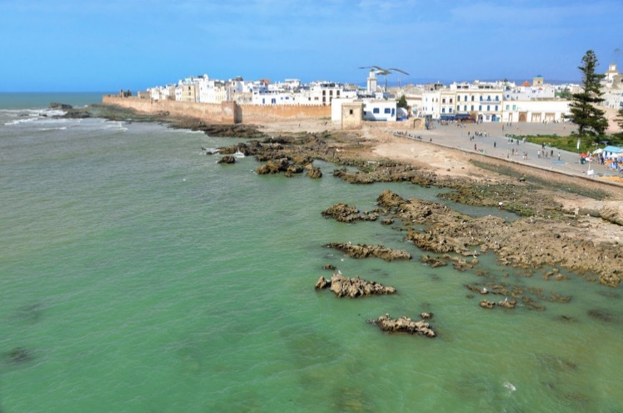
valleys of the Lena River
Dades Gorge
Atlas Mountains
Arctic Ocean
Kasbahs
Essaouira

Slide 5
Discuss in pairs using the text
Where would you like to travel?
What activities would you like to do there?
A: I’d like to go on the ‘Camel Riding in Morocco’ holiday.
B: Really? What would you like to do there?
A: I have always wanted to visit Morocco. There’s lots to do and see, for
example, travel across the desert on a camel, visit historic sites and relax on beautiful beaches. Where would you like to go?
B: I’d like to go to Yakutia in Russia . I’d like drive reindeer sled and explore nature.

Slide 6
Hometask

