Slide 1

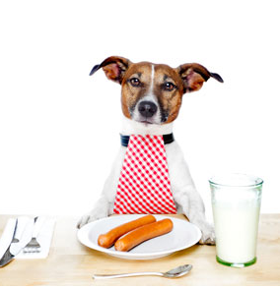
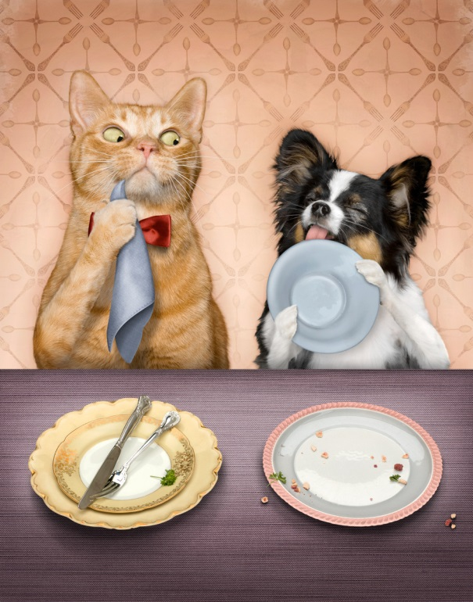
Table manners
Презентация к уроку
по учебному предмету «Английский язык»
в 7 классе
Учителя английского языка
ГБОУ лицея 144
г. Санкт-Петербурга
Дерендяевой Светланы Васильевны
Notes:
ПРИМЕЧАНИЕ. Чтобы заменить изображение, просто выберите и удалите его. Затем используйте значок вставки рисунка, чтобы заменить его собственным изображением.

Slide 2
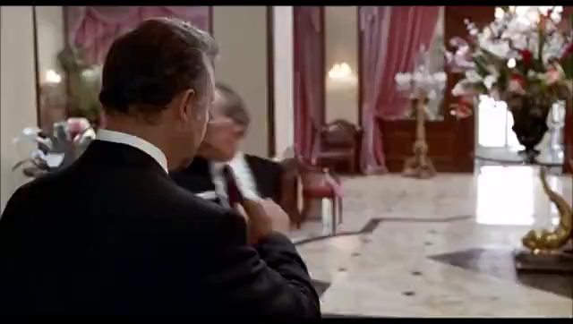
Watch the video and answer the questions
What are we going to talk about?
We are going to talk about the table manners.
Why are we going to talk about them?
We are going to talk about them because we must know and follow the table manners in order to be cultural people. The Table Manners are very important if you eat in a restaurant or at home
What are the table manners?
The Table manners are rules of behaviour at the table
Does the film star really have a problem?
Yes, she does.
What table manners do you know?
She doesn’t know how to behave herself at the table
What problem does she have?
Not to champ, say “thank you, please” etc.

Slide 3
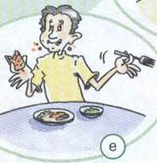
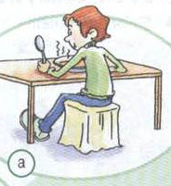
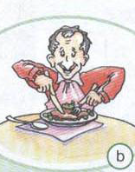
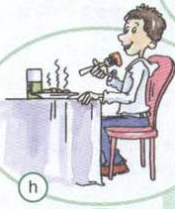
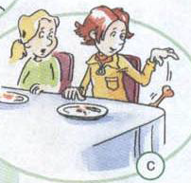
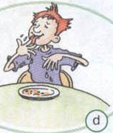
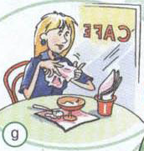
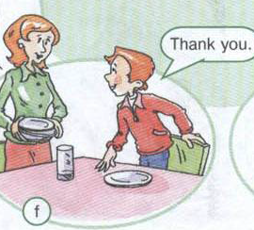
Listen and repeat the words in bold and translate them
Lick [lɪk]
 your fingers
 Say thank you when you finish your meal
knife [nʌɪf]
 Use your and fork or spoon
elbows [ˈɛlbəʊ]
 Put your on the table
 bones on the floor
Throw [θrəʊ]
 Sit up
straight [streɪt]
 Talk with your mouth full
Wipe [waɪp]
 your fingers on a
serviette [səːvɪˈɛt]
napkin [ˈnapkɪn]
 Put the table on our knees
Read, translate the phrases and match them with the pictures

Slide 4
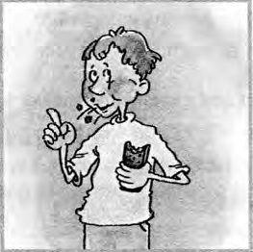
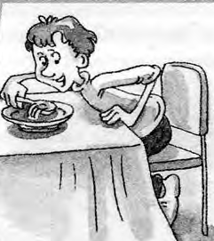
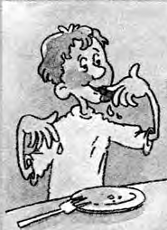
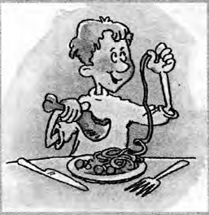
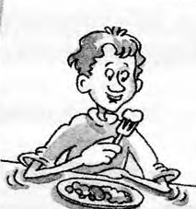
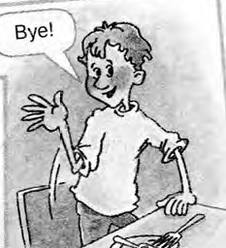
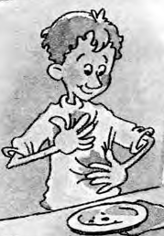
Now make rules about table manners using phrases and pictures
You should… | You shouldn’t…
You should sit up straight
You shouldn’t talk with your mouth full
You should use your knife and fork
You shouldn’t lick your fingers
You should say thank you when you finish your meal
You shouldn’t put your elbows on the table
You should wipe your fingers on a serviette
Add your own ideas for each column

Slide 5
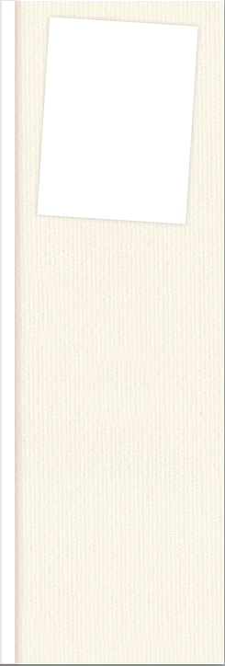


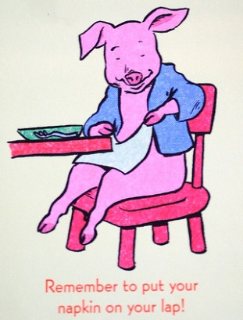
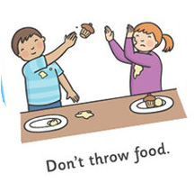

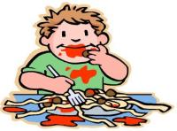
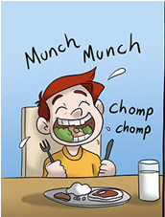
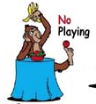
You should put your hats off.
You shouldn’t reach for a dish the salt, or the pepper. Simply say, “Please pass the salt.
You should put napkin on your lap.
You should clean your hands.
You shouldn’t throw food.
You shouldn’t use your fingers
to push food onto your spoon or fork.
You shouldn’t play at the table.
You should chew with mouth closed.

Slide 6
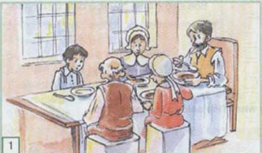
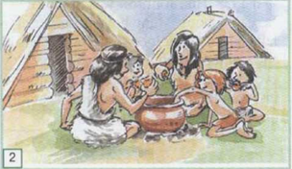
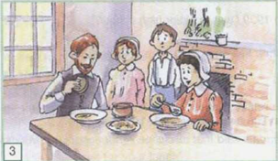
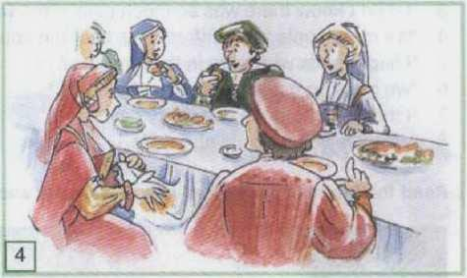
Now you know some table manners, but where did they come from? Let’s read and translate
History of table manners
Table manners are even older than tables. The first rules appeared about 9,000 years ago.
People ate from big pots. Men went first, then women and children.
Sometimes they didn't use spoons. They just picked out pieces of meat with their fingers.
Do you hate sitting up straight at table?
In the times of America's early settlers children didn’t even sit at the table. They stood behind the adults and ate what was given to them.
Later, children were allowed to sit at the table, but they couldn't speak or ask someone to give them something.
In 1530, a man named Erasmus wrote a book on manners. Erasmus told people not to blow their noses or spit at the table. In those days people didn’t have plates. They used big pieces of stale bread. After the meal, the bread was given to poor people. Bones were thrown on the floor
Later, new rules appeared. People learned not to lick their fingers, but to wipe them on the tablecloth. They were also told not to put their faces in their food. They ate from plates, and everyone had his own cup. Bones were not thrown on the floor, but left on the plate.
Find sentences from the text to match the pictures 1 to 4

Slide 7
Using the text, make a list of differences between old table manners and modern table manners
Table manners in the past | Table manners now
People in the past threw bones on the floor.
People in the past wiped fingers on the tablecloth.
Sometimes they didn't use spoons. They just picked out pieces of meat with their fingers.
People didn’t have plates. They used big pieces of stale bread.
We don’t throw bones on the floor.
We wipe our fingers on the napkin.
We use spoon, fork and knife. We don’t eat with fingers.
We use plates.
We have studied the basic table manners that are observed in many countries.
But each country has got its own unusual table manners.

Slide 8
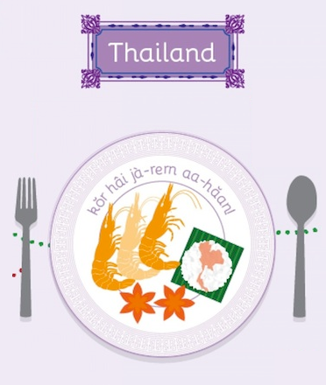
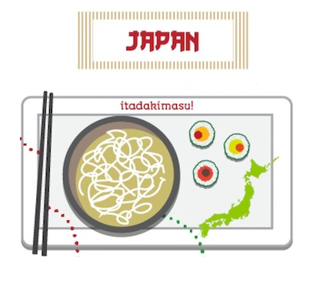
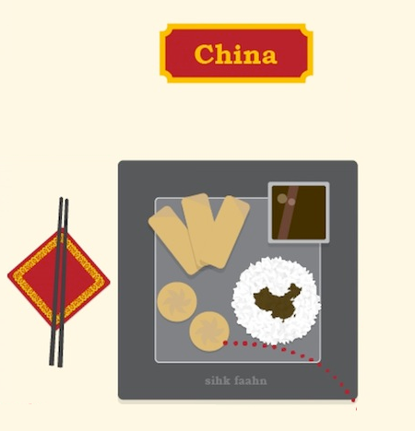

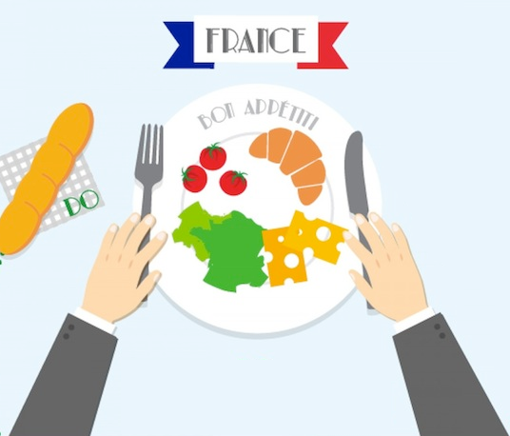
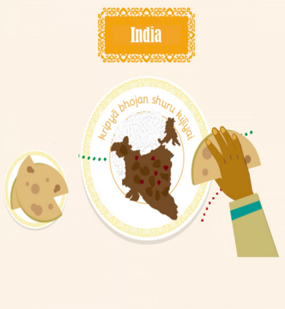
What unusual table manners would you like to learn about?
Work in pairs. Choose the list with the name of country and using the text on it make the table manners:
You should/you shouldn’t…
What country has got the most interesting table manners?
And why do you think so?

Slide 9
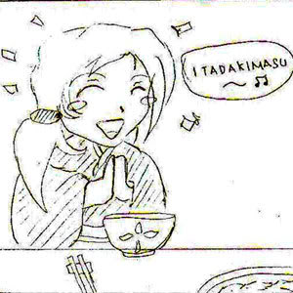
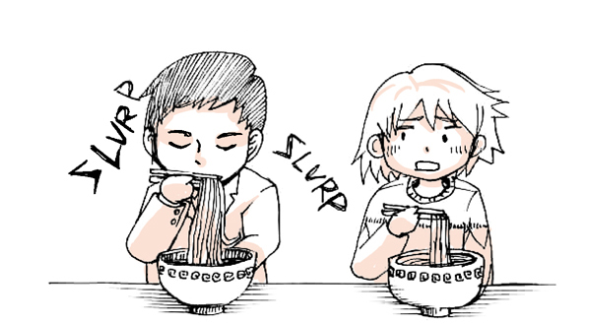
You should say Itadaki-masu for the food and to the person who prepared the food.
You should say gochiso-sam when finish eating to express thanks.
You should slurp your noodles noisily to show love for dish
You shouldn’t cross chopsticks, lick them or insert them vertically into your food.
Japanese table manners
If you eat something with people, you'll hear they say ”itadaki-masu” to show gratitude for the food you eat and to the person who prepared the food. You'll also hear people say ”gochiso-sama” when they finish eating. This is also said to express thanks and to say the dishes were good.
Slurp your noodles noisily (like you did as a child with spaghetti!) because it means you love what you’re eating.
Make sure that when you’re using chopsticks, never cross them, lick them or insert them vertically into your food.


Slide 10
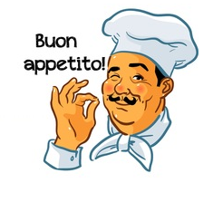
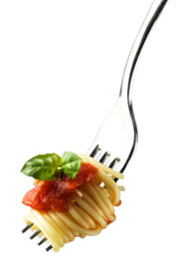
You shouldn’t begin to eat until the host says "Buòn appetito!“
You shouldn’t eat spaghetti with a fork and a spoon. You should eat only with the fork
You should hold your hands above the table, on top of the table .
You shouldn’t ask for extra cheese
Italian table manners
Do not begin eating until the host says "Buòn appetito!“
For Italian people one thing is very important: don't eat spaghetti with a fork and a spoon, but only with the fork.
Your hands should be visible above the table. Rest your wrists on top of the table (never your elbows).
Don’t ask for extra cheese, if it’s not offered.


Slide 11
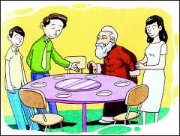
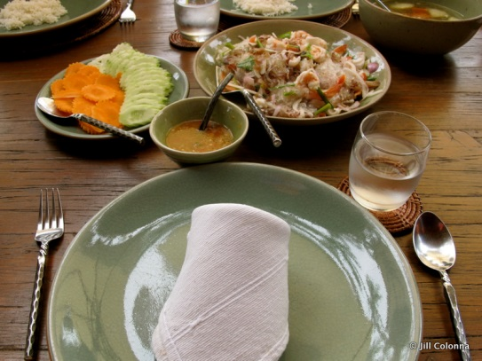
You shouldn’t start to eat before other elderly people start.
You shouldn’t leave the table before the oldest person finishes his meal.
You shouldn’t use knife at the table.
You shouldn’t eat from your fork.
You should use it only to push food onto your spoon.
You should share your dish
Thai table manners
Be careful not to start to eat before other elderly people start. You might look very rude. And you can’t leave the table before the oldest person finishes his meal.
Never use knife at the table. If you need to cut things, use the side of your spoon first.
Don’t eat from your fork , use it only to push food onto your spoon
Be ready to share your dish. Thai meals are always shared.


Slide 12
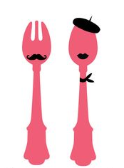
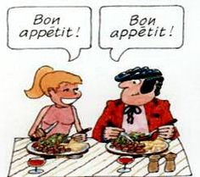
You shouldn’t eat until the head of the table or the host says "bon appétit"
You should keep your hands on the table,
You should send thank you note.
You shouldn’t be late because drinks won't be served until the last guests arrive.
French table manners
Try not to be late because drinks won't be served until the last guests arrive.
Always wait for the head of the table or the host to say "bon appétit" before starting to eat.
Keep your hands on the table, not on your lap. This is very important.
Always send a thank you note the next day, or phone to say thank you.


Slide 13
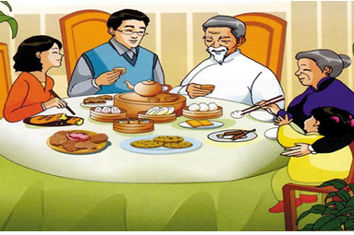
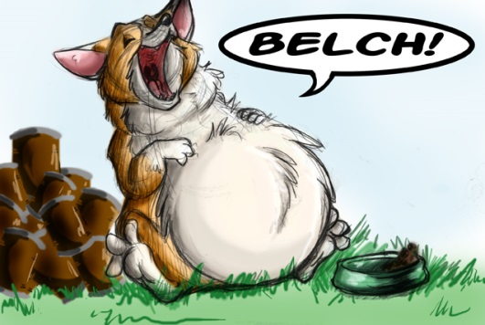
You shouldn’t finish all your food
You should leave a small amount of food on your plate
You should belch to compliment to the chef
You shouldn’t dig through your food
You shouldn’t watch television, use your phone.
You should concentrate on the meal and your companions.
Chinese table manners
Don’t finish all your food, leave a small amount of food on your plate to show that your host gave you more than enough to eat.
Belch! It’s a compliment to the chef.
Don’t dig through your food. It’s rude.
Watching television, using your phone, or carrying on some other activity while having a meal is a bad habit. Concentrate on the meal and your companions.


Slide 14
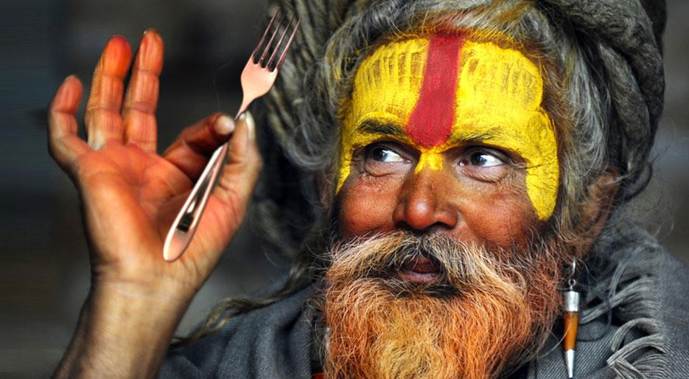
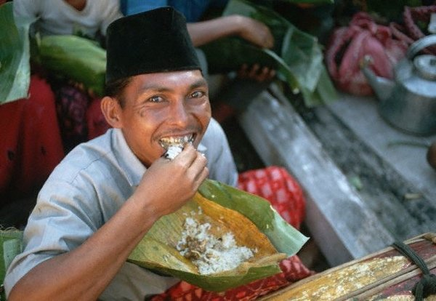
You shouldn’t eat with your left hand
You should use only your right hand.
You should finish all your meal
You should eat not too quickly and not too slowly.
You should wash your hands before you sit down to eat and at the end of the meal.
Indian table manners
Don’t eat with your left hand. It’s considered unclean. Use only your right hand. Do not place your left hand on the table.
Be sure to finish your meal as wasting food on your plate is disrespect.
Don’t eat too quickly or too slowly.
You also need to wash your hands before you sit down to eat and at the end of the meal.


Slide 15
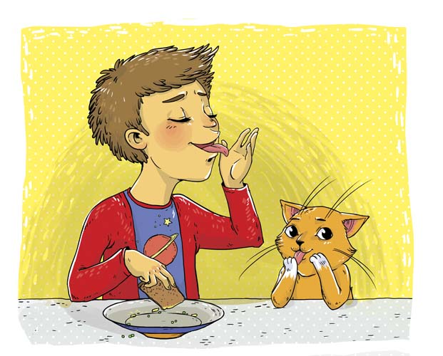
Homework
Make table manners (basic and unusual) in our country, in Russia (50-60 words) and tell about them. If you tell without any mistakes, you will get an excellent mark. If you tell and make some mistakes, it’s a good mark. But if “3” is enough for you, you may only write the text.

Slide 16
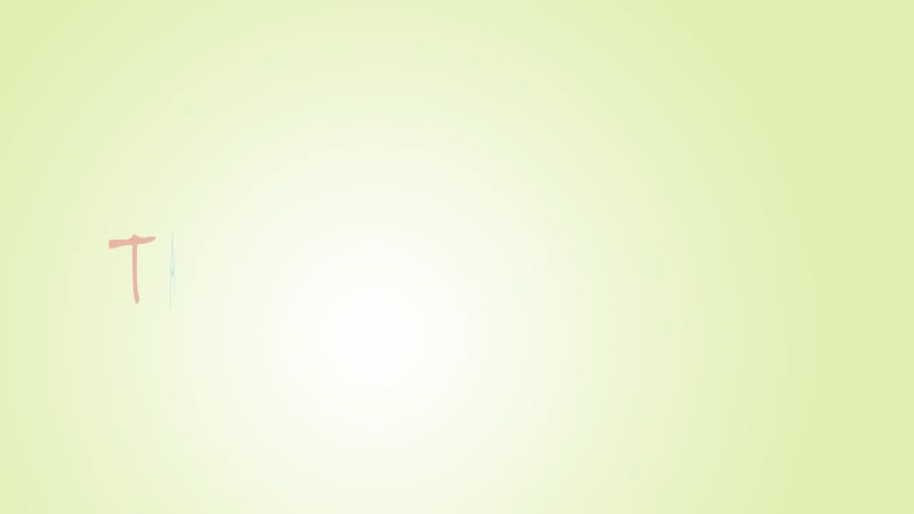
Now let’s remember. Look at the video and answer the question.
What table manners should we observe in order not to be confused?

Slide 17
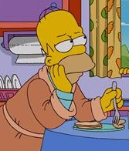
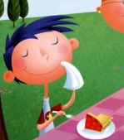
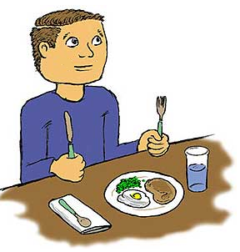
I’m bored.
I have known nothing new.
I’m happy because I’ve known
many interesting things
I didn’t feel any special feelings. It was an usual lesson.
What do you feel at the end of our lesson? Choose one of these pictures.

Slide 18



Enjoy your meal and
Thank you for your attention!

