Slide 1


The power of …

Slide 2

What types of media do you know?
a way to communicate with your partner who might be a thousand miles away using the computer
broadcasting programmes (the news, plays, advertisements, shows) for people to watch on their television sets
broadcasting programmes for people to listen to
a large thin book with a paper cover, containing reports, photographs, stories etc, usually published once a month or once a week
a paper printed and sold usually daily or weekly with news, advertisements

Slide 3





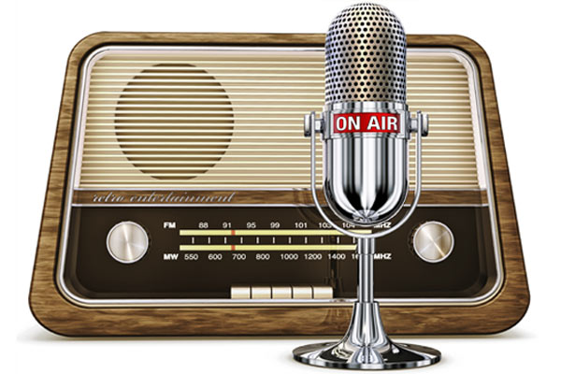
What type of media are we going to talk about? Listen and guess
RADIO

Slide 4
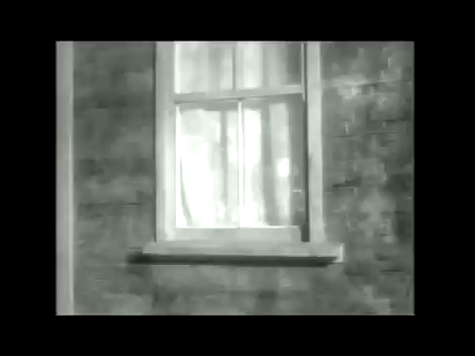
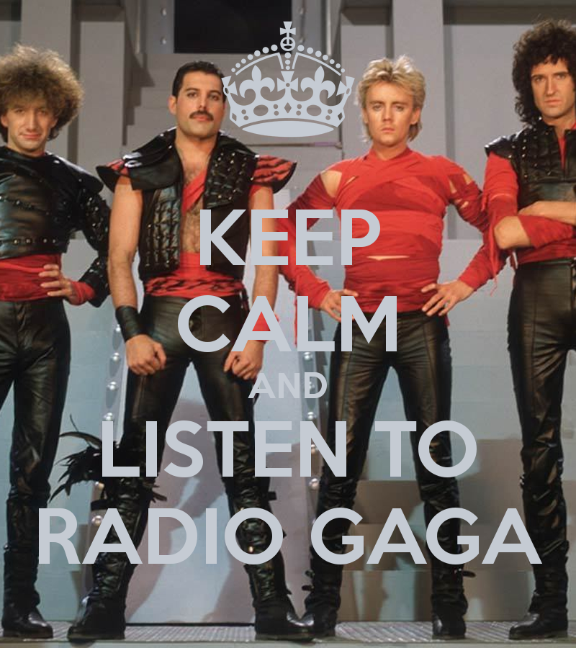
“Radio Gaga”
"Radio Ga Ga" is a 1984 song performed and recorded by the British rock band Queen and their lead singer Freddie Mercury. Recorded in 1983 and released in January 1984, the song was a commentary on television overtaking radio's popularity.

Slide 5

What radio professions do you know?
What verbs related to “radio” do you know?
What can student radio provide students with?
Who can try to make own radio programme?
Why are we going to talk about radio?

Slide 6
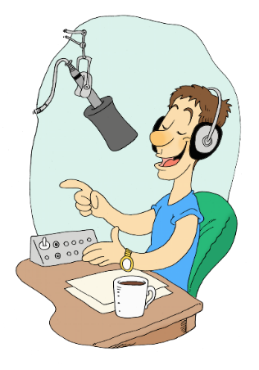
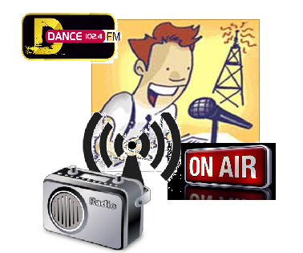
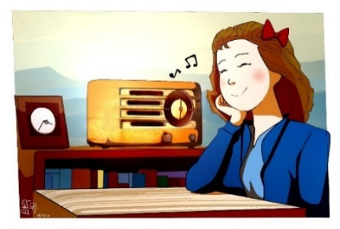
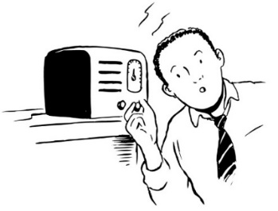
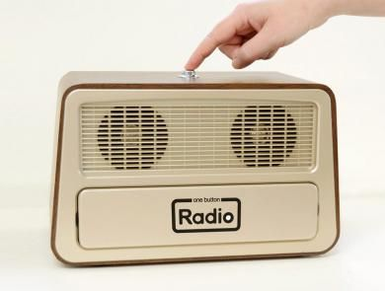


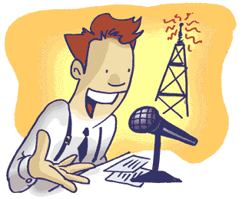
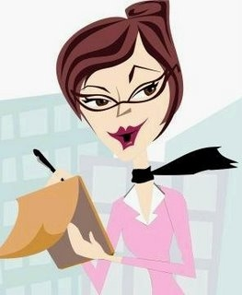
Listen and repeat the words in bold and translate them
broadcast
[‘brɔːdkɑːst]
presenter
radio [prɪˈzɛntə]
journalist
[ˈdʒəːn(ə)lɪst]
technician
[tɛkˈnɪʃ(ə)n]
radio station
engineer
[ɛndʒɪˈnɪə]
radio [ˈɪndəstri]
industry
programme
radio [ˈprəʊɡram]
turn
[tɜːn] the radio on / off
[tjuːn] the radio in
tune
listen to the radio
hear something on the radio
Read, translate the phrases and match them with pictures

Slide 7


Listen to the text about a student radio and put the titles in the correct order. There is one extra title
Good Work Experience
Paragraph 1
Music & Fun
Paragraph 2
Paragraph 3
Up-to-date News
Paragraph 4
Different Roles

Slide 8
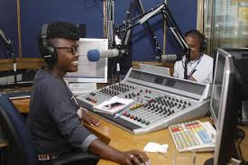
Alison: Good morning listeners and welcome to ‘Breakfast Time’ with your DJ, Alison Cole. We’re coming to you live from the studios of Radcliffe University with the news that matters to you. First, here’s a quick update on the big basketball game last Friday against Sutton. Your Radcliffe Raiders are going on to the championship. That’s right. We knew they could do it. Great job mates! Now for the local news here’s our star reporter, Mark Jackson.
Mark: Thank you, Alison, and good morning to you all. Mr Baker, our Fire Service Chief, is retiring after 40 years of hard work. There is a special celebration for him on 4th June. Make sure you are there. We all wish Mr Baker a pleasant retirement. Traffic is heavy today in the town centre due to road work in Collins Circle. Be careful! That’s it for now. Alison. Back to you!
Alison: Great, Mark. Thanks for that. Let’s get back to the tunes we all know and love. Here’s U2 with “Where the Streets Have No Name” …
come live – выходить в прямом эфире
quick update – последние новости
сhampionship - чемпионат
Fire Service Chief – начальник пожарной службы
retirement – уход на пенсию, в отставку
due to – по причине, из-за

Slide 9
Make your own short radio programme on your latest school or local news
DJ: Good morning listeners and welcome to ________________ with your DJ, _____________. We’re coming to you live from the studios of __________________with the news that matters to you. First, here’s a quick update ________________________________________________________________
__________________________________________________________________________________. Now for the local news here’s our star reporter, _______________.
Journalist 1: Thank you, _____________, and good morning to you all. _________________________ _____________________________ ____________________________________________________
__________________________________________________________________________________. That’s it for now. Back to you!
DJ: Great, ________. Thanks for that. Let’s get back to the tunes we all know and love. Here’s ______
__________________________________________________________________________________

Slide 10
What radio professions do you know?
What verbs related to “radio” do you know?
What can student radio provide students with?
Who can try to make own radio programme?
Why are we going to talk about radio?

Slide 11
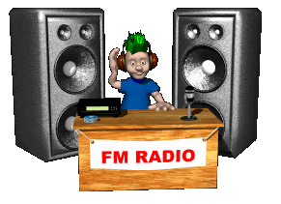
Hometask
Work in group. Record your radio programme that you have already made and play it for the class.

Slide 12
Thank for your attention and don’t switch over!

